Slide 1
Action Modeling with Graph-Based Version Spaces in Soar
Isaiah Hines
University of Michigan
Soar Workshop 33
June 3-7, 2013
Notes:
This was work I completed during an independent study course in the fall of 2012.

Slide 2
Outline
Motivation
Crushed Block’s World
Action Modeling in Soar
Strategy
Version Spaces and Graph Matching
Results
Learned Action Models
Limitations and Improvements

Slide 3
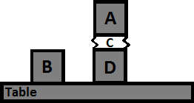
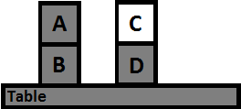
Crushed Block’s World
Move(A,C)
Relations:
on(A, B)
on(B, Table)
on(C, D)
on(D, Table)
clear(A)
clear(C)
clear(Table)
Relation Changes:
+ crushed(C)
+ on(A, C)
- on(A, B)
+ clear(B)
- clear(C)

Slide 4
Crushed Block’s World
Move(A,C)
Each block has 10 binary attributes. A0-A9
If A8=true, then the block can be crushed by other blocks that have A8=false.
Think, stone blocks can crush paper blocks

Slide 5
Options
Episodic Memory
Works well when similarity is a good predictor of an action
Retrieval is not aware of which attributes are important. Episodes may be retrieved that closely match the current state but a block may have a different value for attribute A8
SVS
Causal features and “crushed” result are not within set of SVS detectable relations
Incrementally build Action Models
Create models that begin to predict relational changes
Improve current models when we see new action-result instances
In theory, action models could be incorporated into Semantic Memory

Slide 6
Version Spaces
Represents a list of possible hypotheses that explain the preconditions of an Action Model
Updated incrementally using positive and negative examples
Example
Given 6 binary value attributes
And a list of positive and negative examples
1. <true, false, true, true, false, false> => Positive
2. <true, false, false, true, true, true> => Positive
3. <false, true, true, true, false, false> => Negative

Slide 7
Version Spaces
After seeing the previous positive and negative examples, the following represents all the hypothesis that are consistent with those examples
? Represents values that don’t matter
<true, false, ?, true, ?, ?>
<true, ?, ?, true, ?, ?> <true, false, ?, ?, ?, ?> <?, false, ?, true, ?, ?>
<true, ?, ?, ?, ?, ?> <?, false, ?, ?, ?, ?>

Slide 8
Version Spaces
Can be fully represented by keeping track of only the Specific Hypothesis and General Hypotheses
Specific:
<true, false, ?, true, ?, ?>
<true, ?, ?, true, ?, ?> <true, false, ?, ?, ?, ?> <?, false, ?, true, ?, ?>
General:
<true, ?, ?, ?, ?, ?> <?, false, ?, ?, ?, ?>

Slide 9
Version Spaces
<false, false, true, true, false, false> => ???
Predict the result of a new example using the current Version Space
If the example matches the Specific Hypothesis, it will be positive.
If it does not match any General Hypothesis, it will be negative.
Otherwise it might be either positive or negative.
Specific:
<true, false, ?, true, ?, ?>
<true, ?, ?, true, ?, ?> <true, false, ?, ?, ?, ?> <?, false, ?, true, ?, ?>
General:
<true, ?, ?, ?, ?, ?> <?, false, ?, ?, ?, ?>

Slide 10
Version Spaces in Soar
Instead of a flat list of attributes, a Version Space in Soar consists of a graph, containing objects, relations, and attributes.
Specific Hypothesis in Soar
Graph of objects relations and attributes
New positive examples remove structure in Specific Hypothesis
No General Hypotheses
Cuts down on the amount of state per Version Space
Counter Hypothesis in Soar
List of attributes/relations attached to objects that may cause a negative prediction
New positive examples remove structures in Negative Hypothesis
New negative examples add structures to Negative Hypothesis if the Version Space made an incorrect prediction

Slide 11
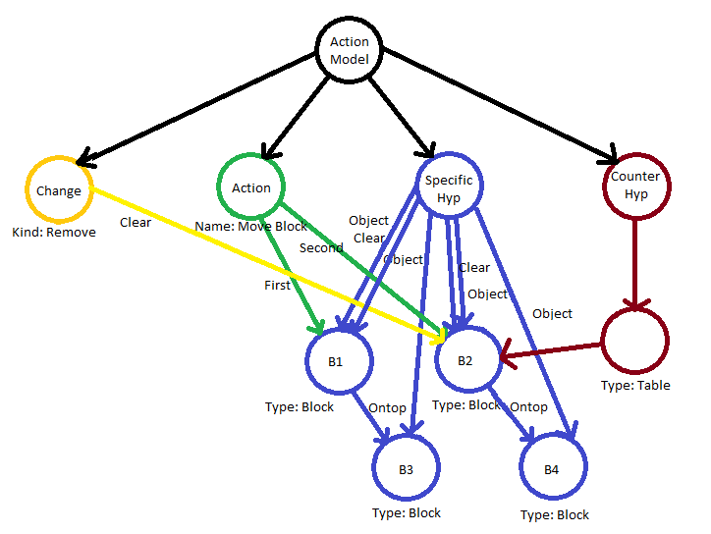
Action Model in Soar

Slide 12
Action-Centric Graph Match
Consider
Agent has some Action Models
Agent wants to perform an action
How does the agent know which action models will apply?
Implemented method
Graph-match between current state and all viable Action Models
Matching is rooted at the action
After the graph-match is complete, evaluate the mapping

Slide 13
Action Model Prediction
Normal Version Spaces
If the example matches the Specific Hypothesis, it will be positive.
If it does not match any General Hypothesis, it will be negative.
Otherwise it might be either positive or negative.
Graph-Match Version Spaces (Heuristic)
Positive
If the example matches the Specific Hypothesis at least to the point where it predicts the addition or removal of a relation
And it does not match any of the attributes in the Negative Hypothesis

Slide 14
Crushed Blocks World Results
Setup
7 Blocks, each with 10 random binary features. Each block also has a name and a type (block or table)
Blocks are in a random starting configuration.
Perform 20 move actions and then completely reset all features and positions
Repeat for 100 resets
Learned Models
Agent learns separate action models for each added and removed relation
4 normal Action Models
6 crushed relation Action Models (1 for each level a block can be crushed at)

Slide 16
More Revealing Data
How quickly are the models learned with respect to actual positive and negative instances
Averaged across 10 trials (20 actions, 20 resets)
Data ends when the Agent no longer makes incorrect predictions
All normal Blocks World relations (no crushing)
~11.4 Actions
~43.1 Predictions
~7 Mistakes
Top layer Crushed Block
~105.6 Actions
~10.5 Predictions
~7.5 Mistakes

Slide 17
Conclusion
Nuggets
Works, where a pure EpMem agent would theoretically fail
Incremental process
Suitable for learning knowledge that can be added to Semantic Memory
Heuristics could be used in cases where there is uncertainty of the graph match
Coal
Version Spaces have various implementations and limitations
Current implementation only works for conjunctive preconditions
Does not work well with nondeterministic environments
All causal attributes must be visible to the agent. The agent cannot learn “new” concepts
Agent does not chunk over action models
Agent does not utilize Semantic Memory

